Slide 1
Applications of Finite Automata
Lecture -5

Slide 2
Topics
Applications of finite automata include
String matching algorithms
lexical analyzers
Network protocols

Slide 3
Pattern Matching
Given a text string T[0..n-1] and a pattern P[0..m-1], find all occurrences of the pattern within the text.
Example:
T = ababcabdabcaabc and
P = abc,
the occurrences are:
first occurrence starts at T[3]
second occurrence starts at T[9]
third occurrence starts at T[13]
The alphabets of both T and P are drawn from finite set Σ

Slide 4
Pattern Matching
T :
P :
a b c a b d a a b c d e
a b d

Slide 5
Algorithms for Pattern Matching
1.Brute Force Strategy
2. The Knuth-Morris-Pratt Algorithm

Slide 6
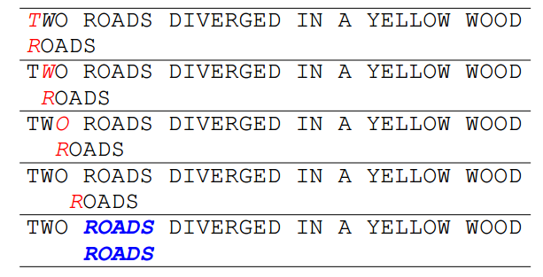
BRUTE FORCE STRATEGY
In this strategy whenever a mismatch was found , the pattern was shifted right by 1 character.
But this wasn’t an efficient strategy as it required a large number of comparisons. Hence a better algorithm was required.

Slide 7
The Knuth-Morris-Pratt Algorithm
Knuth, Morris and Pratt proposed a linear time algorithm for the string matching problem.
A matching time of O(n) is achieved by avoiding comparisons with elements of ‘S’ that have previously been involved in comparison with some element of the pattern ‘p’ to be matched. i.e., backtracking on the string ‘S’ never occurs

Slide 8
How does the O(mn) approach work
Below is an illustration of how the previously described O(mn) approach works.
String S
a | b | c | a | b | a | a | b | c | a | b | a | c
Pattern p
a | b | a | a

Slide 9
The Knuth-Morris-Pratt Algorithm
Step 1:compare p[1] with S[1]
S
a | b | c | a | b | a | a | b | c | a | b | a | c
p
a | b | a | a
Step 2: compare p[2] with S[2]
S
a | b | c | a | b | a | a | b | c | a | b | a | c
p
a | b | a | a

Slide 10
The Knuth-Morris-Pratt Algorithm
Step 3: compare p[3] with S[3]
S
a | b | c | a | b | a | a | b | c | a | b | a | c
p
a | b | a | a
Mismatch occurs here..
Since mismatch is detected, shift ‘p’ one position to the left and
perform steps analogous to those from step 1 to step 3. At position
where mismatch is detected, shift ‘p’ one position to the right and
repeat matching procedure.

Slide 11
The Knuth-Morris-Pratt Algorithm
S
a | b | c | a | b | a | a | b | c | a | b | a | c
p
a | b | a | a
Finally, a match would be found after shifting ‘p’ three times to the right side.
Drawbacks of this approach:
if ‘m’ is the length of pattern ‘p’ and ‘n’ the length of string ‘S’, the matching time is of the order O(mn).
This is a certainly a very slow running algorithm.

Slide 12
Lexical Analyzer
Lexical analysis is the process of reading the source text of a program and converting it into a sequence of tokens.
Example:
For i=1 to max do
X[i]=0;
Token Sequence
for
id
=
num
to
id
do
id
[
id
]
=
num
sep

Slide 13
Lexical Analyzer
Lexical structure of every programming language can be specified by a regular language,
A common way to implement a lexical analyzer is to
specify regular expressions for all of the kinds of tokens
in the language.
The disjunction of all regular expressions describes any possible token in the language.
Convert the overall regular expression specifying all possible tokens into a deterministic finite automaton (DFA).
Translate the DFA into a program that simulates the DFA. This program is the lexical analyzer.

Slide 14
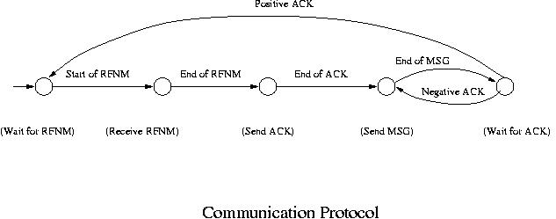
Communication Protocol
Node 1
Node 3
Node 4
Node 2
Node5

Slide 15
Communication Protocol
Initially the computer is in wait state waiting for "Request for Next Message" (RFNM) to come from another computer.
When a RFNM starts coming, it goes into the state of receiving it (Our interpretation is that the computer is in a state of receiving an RFNM and it is taking the action of receiving the RFNM) .
Upon completion of the RFNM, it sends "Acknowledgement" (ACK) to the other computer, which is another state.
After sending the ACK, it starts sending the requested message to the other party. When it is complete, it goes into another wait state waiting for an ACK to come from the other computer.
If a negative ACK is received, it resends the message. If a positive ACK is received, it goes back to the initial state and waits for another RFNM to come.
Thus a finite automaton that models this protocol has the following five states: initial state (wait for RFNM), receiving RFNM, sending ACK, sending message and waiting for ACK.

